Slide 1
Artist Arm
Course Project
CS 684 : Embedded Systems
Guided By
Prof. Kavi Arya
Team 7
Contribution by
Nimit Kalaria* (10305904)
Mayur Mahrotri (10305088)
Shripad Sarade (10305051)

Slide 2
Problem Statement
Draw a Vector image on paper using Artist Arm robot.

Slide 3
Requirement Specification
An image is taken as input
Identify vectors in the image
Draw the vectors using Dexter ER-2 Arm

Slide 4
Work Done in implementation
Image is taken as input
Vectors are identified
Image is scaled to size of paper
Then image is translated to middle of the paper
Only points on vectors are considered. A continuous line is not drawn
Angles are calculated to plot each point and program is generated
The program is run on the robot to plot those points

Slide 5

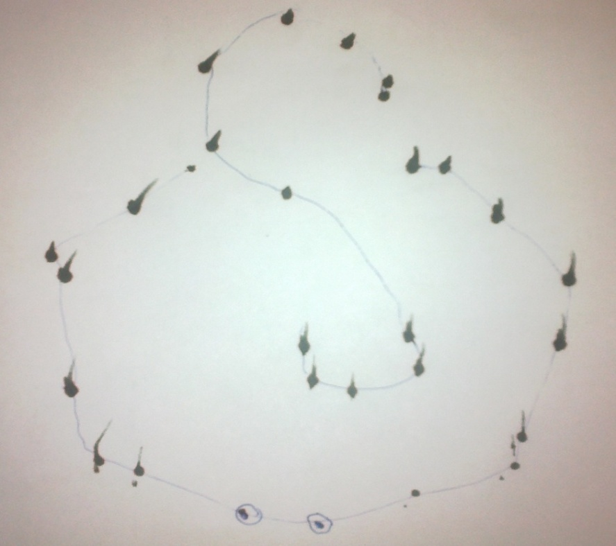
Example
Plotting the outline of the image as points on the sheet of paper.

Slide 6
Problems Encountered
Motor angle calculation for given point.
Brute Force method of angle calculation.
Only one arm is available. Motors damaged once and work halted till robot was repaired
Servo Motors have error associated with it.
Interpolating between two consecutive positions is difficult so only points are plotted. Arm position is reset before plotting every point.
Maximum allowed program size to burn on Arm is 4000 bytes.

Slide 7
Future Work
Study error associated with each motor and define a method to find the error.
Calculate angles using better calculations e.g. Jacobian Method. Current method is brute-force method.
Draw continuous vector by moving smoothly between two points
Develop a better interface for the Robotic Arm which allows smooth movement of Arm-links

Slide 8
Thank You! Questions? ☺

